Slide 1
SharePoint Client Browser
Bram de Jager, @bramdejager

Slide 2
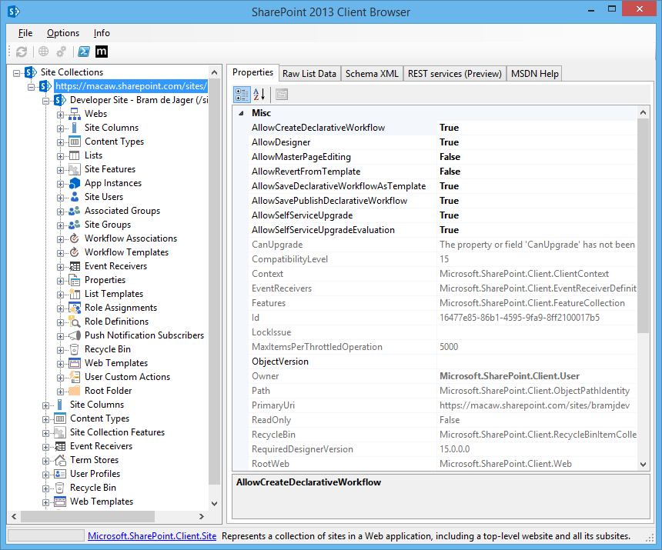
Get insights into your SharePoint site collection

Slide 3
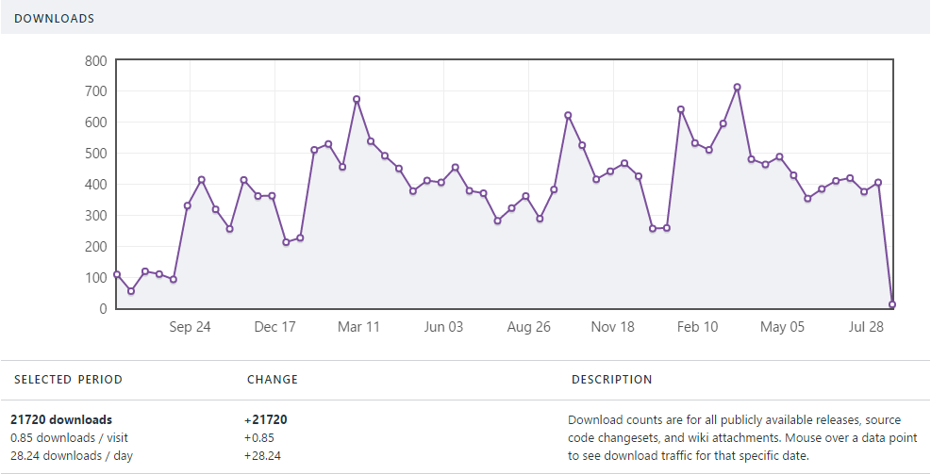
Already more than 21.000 downloads from Codeplex

Slide 4

Already more than 21.000 downloads from Codeplex

Slide 5
Does this add value for you? YES!

Slide 6
1. Download
No installer needed, just download and enjoy
2. Extract
3. Use

Slide 7
Features

Slide 8
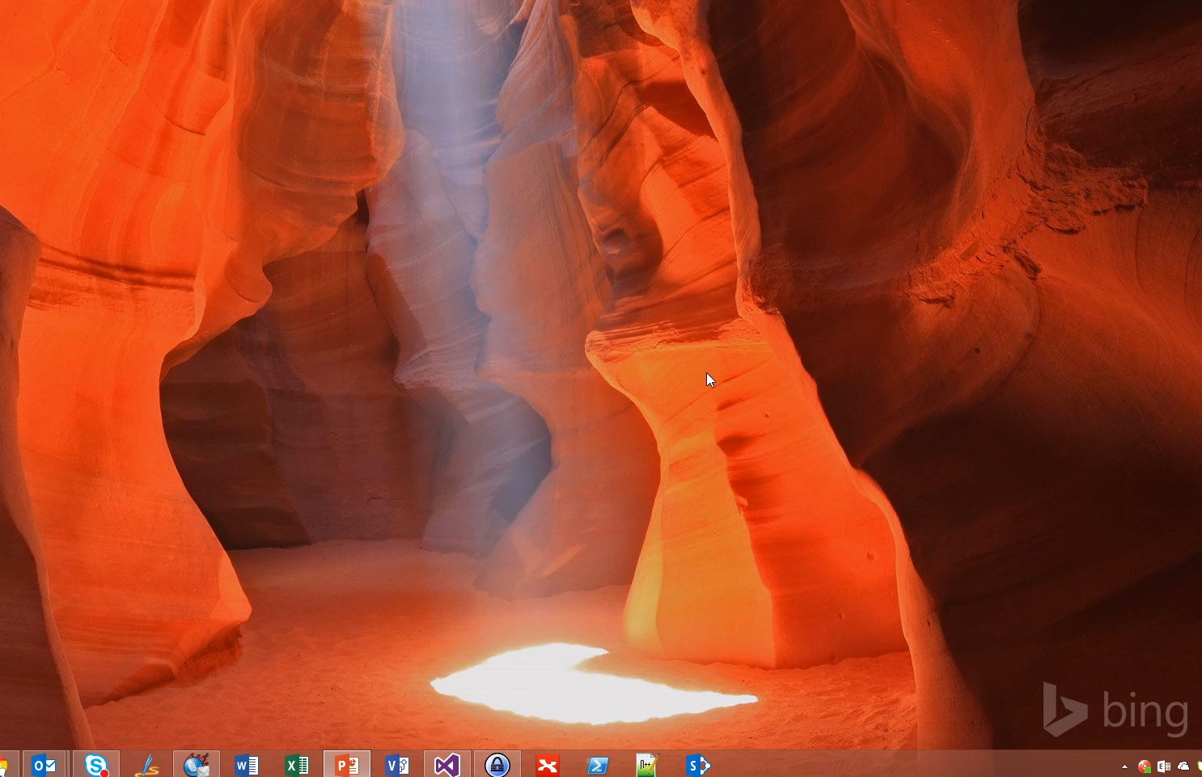
Quick access to recent sites or tenants via taskbar jump menu

Slide 9
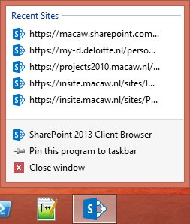
Quick access to recent sites or tenants via taskbar jump menu

Slide 10
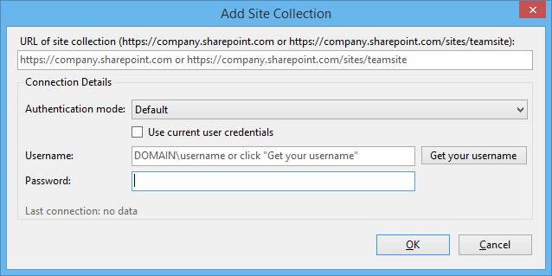
Add new site collection

Slide 11
Authentication support for both online and on-premises
Windows Authentication (NTLM or Kerberos)
SharePoint Online
Anonymous
Forms-based
Claims (AD FS)

Slide 12
PowerShell integration

Slide 13
Open links in default browser or alternative browser

Slide 14
Help by MSDN

Slide 15
SharePoint Client Browser
Download now for free!

Slide 16
